Slide 1
CS250 Lecture 33 – Virtual memory
2017.11.06
“Right now I’m having amnesia
and déjà vu at the same time.
I think I’ve forgotten this before.” ― Steven Wright

Slide 2
Assignment
Read text chapter 13 on virtual memory
Read ahead chapters 14, 15 on input/output
HW09 due Thursday

Slide 3
Typical memory specs
Level | Size in bytes | Typ. access time (ns)
Registers (64) | 512 | 0.25
DRAM (4 GB) | 4,294,967,296 | 60.00
Hard disk (1 TB) | 1,000,000,000,000 | 10,000,000.00
For performance reasons, application program use of hard disk should be carefully managed.
Notes:
Nanoseconds have no visceral meaning: You might seriously say “That was the longest second of my life” but you never say seriously “That was the longest nanosecond of my life!”

Slide 4
Virtual memory (VM) in history
“… a system has been devised to make the core and drum* combination appear to the programmer as a single level store, the requisite transfers taking place automatically.” Kilburn et al., “One-level storage systems,” 1962
*Drum: same concept as a hard disk drive, but much simpler mechanically, using stationary heads located at various positions around a rotating cylinder

Slide 5
Virtual memory motivation
Allow efficient and safe [correct] sharing of memory among multiple programs
Allow main memory to serve as a cache for hard disk drives (transparent to application)
Remove the programming burdens arising from a too small amount of main memory
Note: motivations change with changes in memory technology

Slide 6
1) Automatic management of small memory
If the following processes are loaded into memory:
Internet Explorer (100MB),
MSWord (100MB),
Yahoo Messenger (30MB), and
Windows 3(?) (200MB) require 430 MB in total.
If computer has 256MB memory then user may have to choose an application to quit before can launch another
Virtual memory loads/unload portions of programs to/from memory as needed (automatically)
Can have more applications in memory and do not burden user with quitting an app before launching a new app
Much more of an issue when memory was $$$

Slide 7
Removes programmer burdens
Without virtual memory, if a program is larger than main memory, then programmer must make it fit. How?
Divide program into mutually exclusive pieces of code and associated data that each do fit
Then program the dynamic loading/unloading of these pieces as needed to support execution
Procedure call linking pieces must also be manually loaded/unloaded
Quelle nightmare! (Yikes!)

Slide 8
2) Safe sharing of main memory
Do not know in advance which programs will share main memory
Which programs are in main memory changes dynamically (i.e., all the time)
Thus, we compile every program into its own address space, a separate range of addresses accessible only to this program
VM implements the translation of a program’s address space to physical addresses used in main memory in the computer
Translation enforces protection of a program’s address space from other programs

Slide 9
3) Efficient use of main memory
VM keeps in DRAM only the portion of address space currently in use by program, called the “working set” (program locality)
Working set idea was created by Peter Denning, a former head of Purdue CS Department
The remaining program address space is kept on disk in a special file called "swap space”
Safe sharing permits 1 copy of some information in main memory, rather than 1 copy/program
Shared Libraries among processes

Slide 10
Virtual memory can speed O/S tasks
Loading a program
Virtual memory will load the first page of a program and start execution, then load additional pages when needed, instead of startig only after loading all of the program
Fork a process (gives the child process a copy of the memory of the parent)
Virtual memory lets child process use parent’s physical memory locations initially
No need to immediately copy all of the parent environment for the child, sharply reducing the work needed to launch the child; makes fork call fast
Virtual memory provides “copy-on-write” capability to allow parent and child to diverge

Slide 11
VM & cache in the memory hierarchy
Cache hardware manages information movement between DRAM and CPU
Virtual memory HW and SW manages info movement between magnetic disk and DRAM
Virtual memory and cache concepts are the same, just at different size and time scales
Differing historical roots of the two technologies have lead to the use of divergent terminology

Slide 12
VM & cache terminology relationships
Virtual memory block is called a page
Virtual memory miss is called a page fault
Virtual memory mapping process:
CPU emits a virtual address that is translated (mapped) by a combination of HW and SW to a physical address used to access main memory
Cache mapping process: done entirely with combinatorial (memoryless) HW circuits [fixed at time of manufacture]
Translation is also called memory mapping or address translation
Involvement of SW in translation, instead of a pure HW solution, implies some aspect of virtual memory is or can be (a) very slow or (b) very slow if done sub-optimally

Slide 13
Virtual memory implementations (historic)
Historic
Process swapping – entire memory footprint of a process is moved in and out (swapped) between memory and disk
Segment swapping – entire parts (segments) of a process, as determined by a programmer, are swapped
Drawbacks
Too much information is moved at a time: both slow and inefficient (swap more than necessary)
Pieces moved vary in size: inefficient

Slide 14
Virtual memory today: (Demand) Paging
Unit of memory swapped is a fixed-size page
Page size is a design choice optimized to disk drive memory technology of the day
Historic size: 512 bytes; Today size: 4 or 8 KBytes
Program working set is well-approximated by loading an integer number of pages in memory
Time to load a page is huge, circa 10⁷ nanoseconds
Thus, seek to never, …, never load same page twice
Load a page >1 only if page replaced == had a conflict
Thus, operate main memory as a fully associative cache to eliminate conflict misses [compulsory and capacity misses are inevitable]

Slide 15
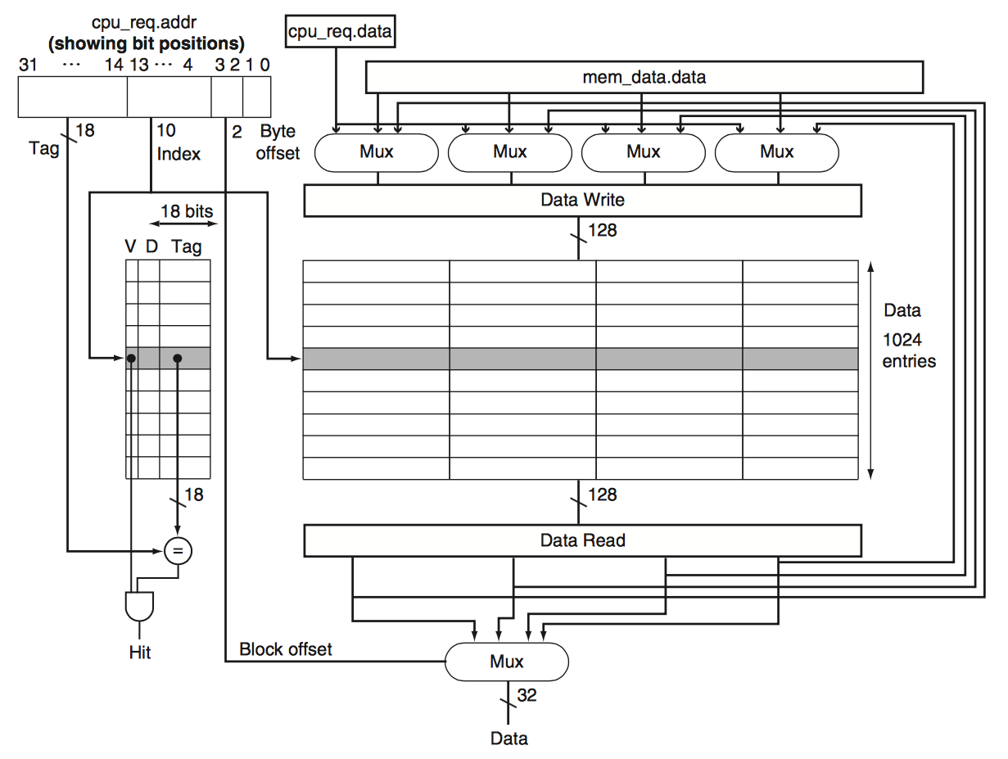
Cache is memory of type struct Block
struct Block{ bit Valid; bit Dirty; usigned_int_18 Tag; word_32 Zero;
word_32 One;
word_32 Two;
word_32 Three; };
struct Block cache[2^index];
Building this struct in hardware makes sense because
cache is small and must be fast

Slide 16
Fully associative main memory
Memory divided into aligned page frames of size = page size
Fully associative means: any page may be placed in any page frame
To find a given page need an analogy to tag matching, called the page table
Cannot afford custom hardware struct, as per cache, and also have massive capacity
Commodity DRAM (type word) forces use of software lookup of a page in a data structure

Slide 17
Paging terminology
Resident: a page that is currently in main memory
Resident set: pages from a given application that are in main memory
Seek to have resident set trend toward the working set

Slide 18
Paging design, high level considerations
Keep working set in DRAM; leave the rest in today’s slow non-volatile storage (hard disk or SSD)
Choose large enough page size to amortize the very large time for (cost of) disk or SSD access
Amortize – to gradually compensate for the initial cost
Focus on reducing page faults via accurate, predictive page replacement algorithm(s)
Use write-back because
Pages are very large compared to most data items in programs, so one dirty page can absorb many CPU store instructions to amortize the cost of a one page write-back
Huge disk access time means a write-through is too slow

Slide 19
Paging design, more detail
Use hardware to process addresses from CPU and to detect pages not in main memory
Use software to
Move pages on demand between disk and main memory
Manage virtual memories of multiple processes
Configure hardware

Slide 20
Mapping virtual addr. to physical addr.
Fully associative placement means index field has 0 bits; address completely specified by tag and offset fields.
Page size in bytes = 2^(Offset field size in bits)
Virtual address from CPU
63 62 … 13 12 11 10 … 1 0
Virtual page number (like cache tag) Page offset
Translation using page table
31 30 … 13 12 11 10 … 1 0
Physical page frame number Page offset
Physical address to main memory

Slide 21
Address translation, or mapping
Virtual memory address space
Physical memory address space
A page frame is an aligned, contiguous block of physical memory of a size equal to the size of a page.
A page of virtual memory space precisely fits in any physical frame.
Virtual memory address space is typically much larger than physical memory address space.
Address translation, or mapping
Page
Page frame
Page
Page frame
Page
Page frame
Page
Page frame
Page
Page frame
Page
Page frame
Page
Page frame
Page
Page
Page
Swap space using disk addresses, e.g., inodes

Slide 22
Paging data structure
Known as a page table
One page table per process
Created and managed by the operating system
Page table is a 1-dimensional array
Indexed by virtual page number
Table entries contain
Translation into physical memory page frame number: High-order bits of a pointer
Valid bit; reset if page is currently on hard disk
Page metadata: access permissions, Dirty bit, bits to support replacement algorithm

Slide 23
Example page table (page map)
For 32-bit virtual addresses, 4096-byte pages, 24-bit physical memory address.
Virtual address range (shown in gray) is not included in an actual page table.
Virtual address range | Virtual page | Mapped to | Page metadata
0x00000000 to 0x00000FFF | 0x00000 = (0)₁₀ | Page frame 0x024 | Text. Read only, Executable
0x00001000 to 0x00001FFF | 0x00001 | Page frame 0xF05 | Data. Read, Write, not Dirty
0x00002000 to 0x00002FFF | 0x00002 | Page frame 0xXXX | Invalid
0x00003000 to 0x00003FFF | 0x00003 | Swap space (via inode) | Swap. Read, Write, not Dirty
… | … | … | …
0xFFFFE000 to 0xFFFFEFFF | 0xFFFFE | Page frame 0xF43 | Read, Write, not Dirty
0xFFFFF000 to 0xFFFFFFFF | 0xFFFFF = (2²⁰-1)₁₀ | Page frame 0x010 | Read, Write, Dirty

Slide 24
Translate CPU read at location 0x00000124
Page size = 4096 = 2¹² bytes means 12-bit (3 hex digits) Offset field, so CPU virtual address field is 20-bit page number, 12-bit offset, thus parse 0x00000124 as 0x00000 = virtual page, 0x124 = byte offset within page.
Main memory page frame size = 2¹² bytes plus 24-bit byte addresses means page frame numbers are 12 bits. Lookup page frame in table, append offset yields hardware address. Use blue table row.
Virtual address 0x00000124 from CPU translates to → (0x024 append 0x124) = 0x024124 main memory hardware address [gray column not a part of an actual page table]
Page 0x00000 metadata allows read, so hardware performs CPU request
Virtual page | Mapped to | Page metadata | Hardware address
0x00000 = (0)₁₀ | Page frame 0x024 | Read only, not Dirty, Executable (Text) | 0x024XXX
0x00001 | Page frame 0xF05 | Read, write (Data), not Dirty | 0xF05XXX
… | … | … | …
0xFFFFF = (2²⁰-1)₁₀ | Page frame 0x010 | Read, write, Dirty | 0x010XXX

Slide 25
Translate CPU write at 0x00000124; SEGV
As before:
Virtual 0x00000124 → (0x024 append 0x124) = 0x024124 hardware
However,
Page 0x00000 metadata does NOT allow write into this page
So memory hardware tells operating system about this memory access violation
The operating system then forces this process to exit (terminate) with a SEGV (memory SEGmentation Violation) error
Virtual page | Mapped to | Page metadata | Hardware address
0x00000 = (0)₁₀ | Page frame 0x024 | Read only, not Dirty, Executable (Text) | 0x024XXX
0x00001 | Page frame 0xF05 | Read, write (Data), not Dirty
… | … | …
0xFFFFF = (2²⁰-1)₁₀ | Page frame 0x010 | Read, write, Dirty

Slide 26
Translate CPU read at 0x00002000; Page fault
Virtual address 0x00002000 → Invalid
Page 0x00002 page metadata says Invalid; this is a “cache” MISS
Memory hardware signals operating system of this miss, called page fault
The operating system then executes code to (1) retrieve this page from the executable file on disk, (2) decide which memory page frame will hold the requested page, (3) if necessary, write-back replaced page, (4) write page 0x00002 into DRAM, (5) update page table entry, and (6) restart the process at the point where it reads at 0x00002000
Virtual page | Mapped to | Page metadata | Hardware address
0x00000 = (0)₁₀ | Page frame 0x024 | Read only, not Dirty, Executable (Text) | 0x024XXX
0x00001 | Page frame 0xF05 | Read, write (Data), not Dirty | 0xF05XXX
0x00002 | Page frame 0xXXX | Invalid | n/a
… | … | … | …

Slide 27
Backing store
Each page in the virtual address space is backed by a file on disk (memory hierarchy Rule 1 support for this page)
Swap space is a designated region of a disk, called a partition, used by the virtual memory system to store transient data
Process Memory Section | Backing Store
Text | Executable File
Data | Executable File when page is not modified; Swap space when page is modified
BSS | Swap Space
Heap | Swap Space
Stack | Swap Space

Slide 28
Summary
Virtual memory analogous to caching
Supports memory access control, helps catch software bugs
Supports having many processes share main memory yet be isolated from each other
Today’s memory technologies, DRAM and disk or flash, require fully associative page placement to achieve adequate performance

Slide 29
CS 250 Lecture 34 & 35 – Paging implementation
2017.11.10
“If the dream is a translation of waking life, waking life is also a translation of the dream.” - Rene Magritte

Slide 30
Paging implementation
Paging adds an extra indirection to main memory access
Use hardware support in the form of a Memory Management Unit to reduce access time (overhead)
Typically,
Access to configure the MMU restricted to the operating system
Operating system runs without memory mapping
Processor mode changes to virtual when running an application

Slide 31
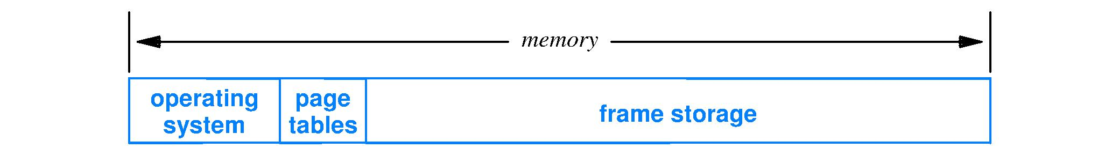
Where are page tables stored?
In main memory, above (at higher numbered addresses than) the operating system
A hardware accelerator is common to help with managing page tables; called the Memory Management Unit (MMU)

Slide 32
Addressing and translation
CPU
Data bus (bidirectional)
Virtual-address bus
Virtual address bus
L1, L2, … cache
Physical address bus
Virtual-address bus
Memory Management Unit (MMU)
Page Table Register
Translation Look-aside Buffer (TLB)
DRAM
Page table 0
Page table 1
…
Physical-address bus
Page table n
I/O devices

Slide 33
Virtually-addressed caches (L1, L2, L3)
Typically, MMU is below the caches (L1, L2, L3) in the memory hierarchy
Addresses used by cache hardware are virtual
Every process uses the same set of virtual addresses, e.g., 0x00000000 to 0xFFFFFFFF
How distinguish a block of one process from the block of another?

Slide 34
Disambiguating cache blocks
Two approaches for distinguishing cache blocks from two different processes but with identical virtual addresses
Operating system invalidates all cache blocks when switching execution from one process to another
Cache hardware augmented to include a process ID alongside the tag

Slide 35
Fast address translation is essential
Address translations occur for each memory access that goes outside the processor chip
Today, typically, this is any memory access that misses in the lowest cache level
Translation performed by the MMU
Translation time contributes to the von Neumann bottleneck
Page table in DRAM; lookup requires a slow DRAM access
A faster way: cache recent translations

Slide 36
Translation lookaside buffer
A translation cache invented by IBM
In a size N content-addressable memory (CAM) store recent translations: (Virtual page number, hardware page frame)
When a translation is needed MMU queries CAM at same time it starts page table lookup
Translation time = min(CAM, table lookup)
Program locality means CAM will have needed translation 90% of the time for affordable N

Slide 37
Memory Management Unit (MMU)
Page Table Register
Holds pointer to the current page table, the one to use for translations for the current process
This register is updated with every context switch from one process to the next
One page table in main memory per process
Page table
Holds virtual page to physical page frame mapping
Holds valid bit, dirty bit, permission bits and other metadata for each page
A page fault (miss) is signaled by the MMU

Slide 38
Practical page tables
Page table maps each virtual page; for a large virtual address space (desirable) this implies a large table. Example, 40-bit byte-address memory:
40-bit virtual address & 16 Kbyte pages (2¹⁴ bytes)
2⁴⁰/2¹⁴=2²⁶ pages each with, say 4-byte table entry = 0.25 GB size of page table for each process
Most programs use a small portion of the full virtual address space, so most page table entries are marked “invalid” and, thus, are wasted main memory
Reduce main memory waste by using a multi-level page table

Slide 39
Two-level page table
Virtual page number field split into two parts: first-level and second-level page numbers
Every process has a first-level table
Second-level tables allocated only when the table will contain a valid entry
No more vast extents of main memory used to hold table translations marked Invalid

Slide 40
Two-Level page tables
The page number is divided into two parts: first-level page number and the second-level page number
Example: VM address:0x00402657
Offset=0x657 (last 3 hex digits)
1st level index = 0x001 , 2nd level index = 0x002
First-level index (10 bits)
Second-level index (10 bits)
Offset (12 bits)
00 0000 0001 00 0000 0010 0110 0101 0111
First level
Second level
Offset

Slide 41
Address Translation
Second-level page tables (multiple tables for each process ONLY as needed)
Page frame number in physical mem
Virtual address
1st level 10 bits
2nd level 10 bits
Offset 12 bits
2¹⁰-1
…
9
10
10
31 22 21 12 11 0
9
First Level Page Table
(one for each process); hold pointer to second-level table
0x65000
8
2¹⁰-1
7
7
6
5
2
5
2¹⁰-1
0x65000
4
4
0x70000
3
0x45000
2
1
0
0x70000
0
0x45000
Red = various translations in tables

Slide 42
Address Translation
Virtual address = 0x00402657
Second-level page tables (multiple tables for each process ONLY as needed)
Page frame number in physical mem
2¹⁰-1
…
0x001
0x002
0x657
9
10
10
31 22 21 12 11 0
9
First Level Page Table
(one for each process); hold pointer to second-level table
0x65000
8
2¹⁰-1
7
7
6
j
5
2
5
2¹⁰-1
0x65000
4
4
0x70000
3
0x45000
2
1
0
i
0x70000
0
0x45000
Blue = translation of 0x00402657
Black = other translations in tables

Slide 43
Page metadata
In example, each table entry uses 20 bits to store the page number (2³²/2¹² = 2²⁰ pages)
Given a 32-bit memory word, use other 12 bits to store metadata
Valid bit, dirty bit
Permission bits: read, write, execute
Bits to support page replacement algorithm

Slide 44
Types of page fault
CPU tries to access a page not resident in main memory
Metadata valid bit marked “invalid”
MMU will generate a signal to the operating system kernel to load the page from disk
CPU tries a memory access that violates one or more permission bits
MMU generates a signal to the operating system which stops the process with a SEGV or other error message

Slide 45
Handling a page fault
Page fault happens when CPU tries to read or write at an address in a non-resident page
MMU performs translation and finds page resident bit is not set
MMU generates a page fault signal to the operating system (O/S)
Execute a call to the O/S, saving the current_instruction_pointer (PC) and all CPU registers in the stack and changing mode to one appropriate for the O/S

Slide 46
Handling a page fault
Based on signal from MMU, O/S code calls page fault handler
The page fault handler • Checks if the faulting address from the process corresponds to a page that is not valid for this process, if yes, then generate a SEGV signal to the process. The default behavior for SEGV is to kill the process and dump core • Otherwise, the page fault handler
Finds a free page frame in physical memory. If no free page frames, then plan which one to re-use; if frame contains a dirty (changed) page, then first write that page to disk

Slide 47
Handling a page fault
Load from disk the virtual page that will satisfy the page fault
Update the translation table entry for the virtual page with the chosen page frame number and set the metadata bits appropriately (e.g., clear the modified bit, etc.)
Restore CPU registers, return to process causing the page fault, and retry (re-fetch) the instruction that caused the page fault
The page fault is completely transparent to the program, that is, the program will have no knowledge that the page fault occurred

Slide 48
Summary
Demand paged virtual memory
Is a form of caching
Makes use of fixed size idea to speed operation
Lets main memory be shared in many ways
Speeds creation of child processes, allocation of zero-initialized memory
K-level page tables conserve main memory space

Slide 49

CS250 Lecture 36 – Input/output
2017.11.13
I/O, I/O, so off to work I go. – bumper sticker seen in Silicon Valley

Slide 50
Assignment
This week chapters 14-17
For next week (after Thanksgiving), read chapters 18 and 20
HW10 due Thursday
Lab 09 issues this week, due the week after Thanksgiving

Slide 51
Announcement
No lectures on Monday, Nov. 20
No labs on Tuesday, Nov. 21

Slide 52
Input/output (I/O) devices
I/O devices connect a computer to the world
Wide range of types (the world is complex)
Keyboards, mice, trackpads
Displays, touch displays
Hard disks, solid state disks (SSD)
Printers
Speakers
Cameras
Sensors
Actuators
and on and on …

Slide 53
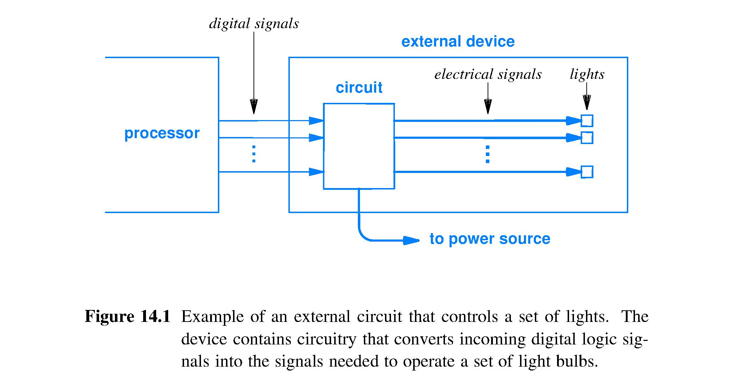
Properties of an I/O device
Operates independently of the processor
May have a separate (different) power supply, clock
Digital signals used for communication and control

Slide 54
Parallel interface
Extends the idea of the computer bus, or data path
Many wires, each carrying 1 bit at a time
Interface width is the number of wires
Increasing the interface width
Increases throughput
Increases cost
Increased interface speed (higher rate of sending bits on each wire)
Increases crosstalk between parallel wires
Bit on each wire interferes with all bits on other wires (right hand rule of changing magnetic fields around current-carrying wires, cf. magnetic core memory)
Notes:
Magnetic core memory takes advantage of the “crosstalk” between the vertical and horizontal wires to achieve a magnetic field strong enough to flip the magnetization direction of a core.
Here, crosstalk is just a liability to the performance of the system.

Slide 55
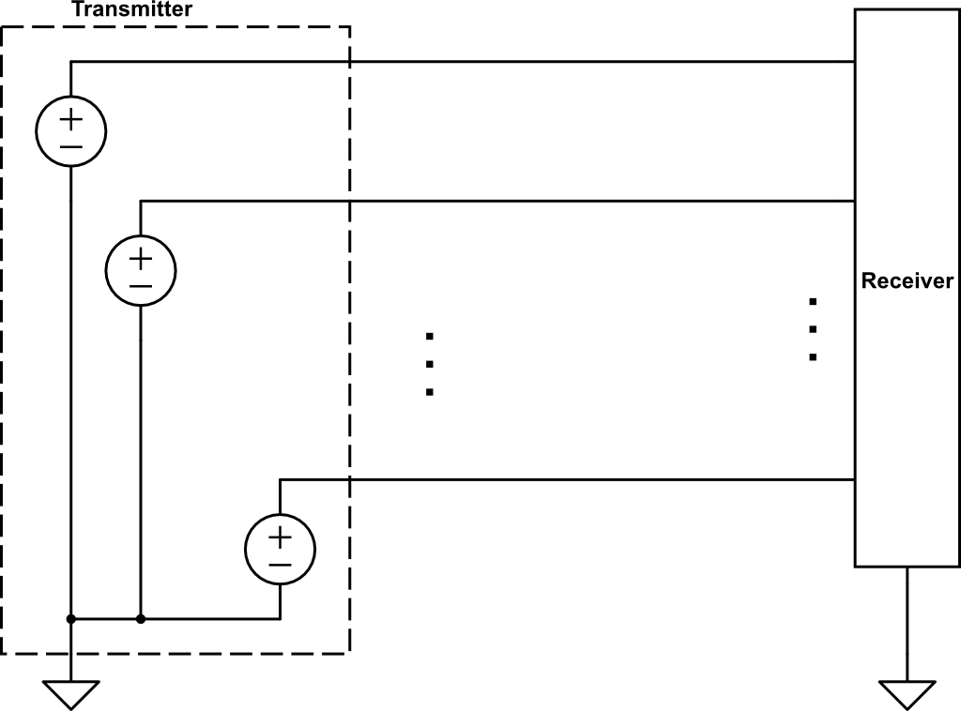
Signal line
Crosstalk: signal in one wire couples electro-magnetically to each other wire, adding noise to the intended signal, making the receiver more likely to interpret a received value as other than the transmitted value
0, 1 voltage signal
0, 1 voltage
. . .
0, 1
Ground path completes the circuit

Slide 56
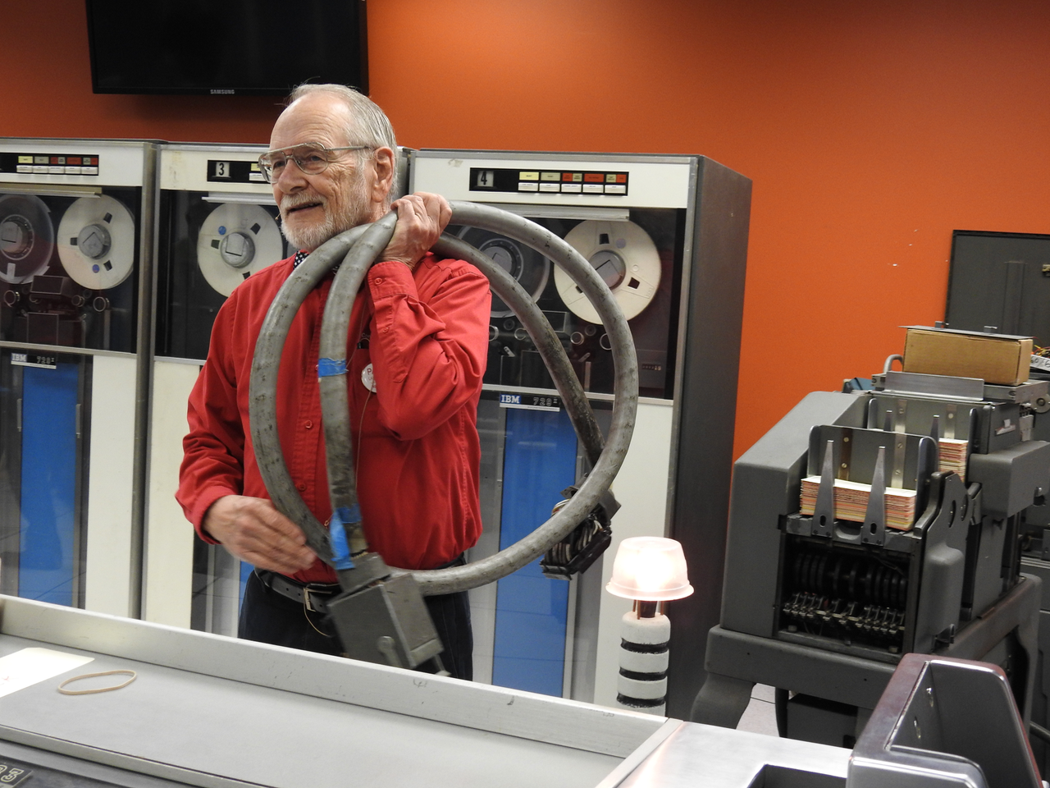
Historic: parallel interface for IBM 1401
Parallel printer cable, circa 20 kg

Slide 57
Serial interface
Basic concept, same as parallel, except
One signal wire plus ground path
Receiver gets one incoming bit at a time by measuring voltage between wire and ground
Pro
Simple, cheap hardware
Con
A wire crossing space between transmitter and receiver acts as an antenna for all electromagnetic (EM) energy in that space
EM energy induces varying voltage in antenna wire with respect to ground; adds to/subtracts from signal voltage
Strong noise will cause received signal voltage to “cross the gap” between voltage bands for 1 and 0 resulting in errors in received bits
Conclusion: unworkable in practice without a ferrite choke to suppress noise, or a shielded cable (more costly) to block noise

Slide 58
Differential serial interface
Concept
Use two wires to carry 1 bit with 1/0 voltage levels measured between the two wires (“differential” voltage)
Pro
Hardware still cheap compared to parallel bus
EM induces identical noise voltage in each wire with respect to ground
Thus, EM has no effect on differential voltage between two wires; if receiver measures difference voltage then it is deaf to the noise but not to the signal
Increasing the interface speed does not cause as much crosstalk as in a parallel interface because only 2 wires to cross talk: Bonus
Example: USB

Slide 59
Coordinating independent clocks
Logic at each end of an interface may have its own clock (most often, does)
Transmitter clock sets the time each bit is sent
Receiver samples incoming voltage to detect each bit
Need to synchronize receiver clock with transmitter clock so samples are taken properly

Slide 60
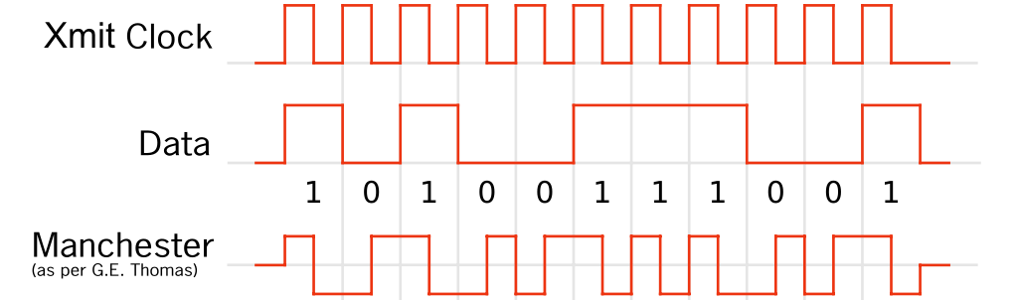
I/O signals and receiver clocking
Receiver samples (measures) the signal periodically
When to sample? When receiver clock says to
What if transmitter and receiver do not share a clock signal (almost always the case, for various reasons)?
Also transmit clock, making the interface more parallel, OR
“Embed” clock signal into the data signal: Self clocking
Also transmit clock, making the interface more parallel
Not available to receiver; Use data signal edges to estimate clock falling edge
Data signal edge intervals vary; larger interval means lower precision time at receiver (drift)
1
1
1
1
1
1
0
0
0
0
0
Self clocking
Falling edge = 1, Rising edge = 0, so edge at right time is data and clock
Regardless of data sequence, maximum signal-edge interval = 1
Notes:
The problem is that too long a sequence of the same symbol may allow the receiver clock to drift sufficiently that it looses a correct count of the number of symbols in the constant string.

Slide 61
I/O interface terminology
Full duplex – simultaneous, bidirectional transfer of data
Half duplex – transfer data in one direction at a time; communicating devices must negotiate direction before transmitting
Latency – time to perform a data transfer
Throughput (informally called speed) – amount of data transferred per unit time
I/O device and network speeds in units of powers of ten

